Slide 1
COMP814 – Text Mining Writing a Scientific Paper.

Slide 2
Assignment 2 General Comments
Assignment task in perspective
Two most popular topics
Two vectorization techniques.
Purpose of Abstract

Slide 3
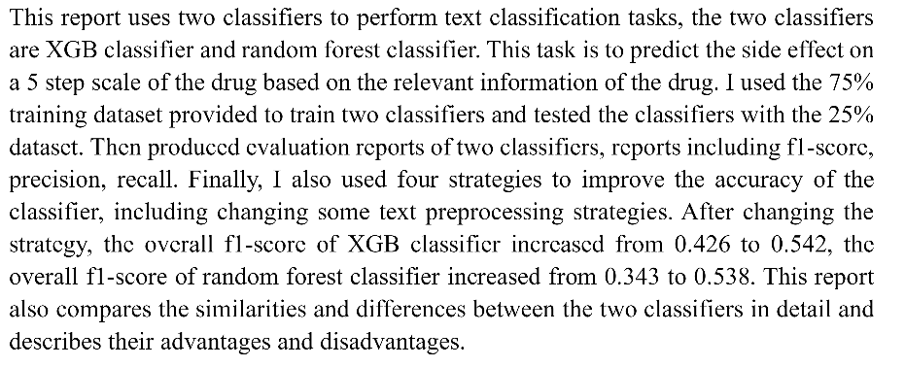
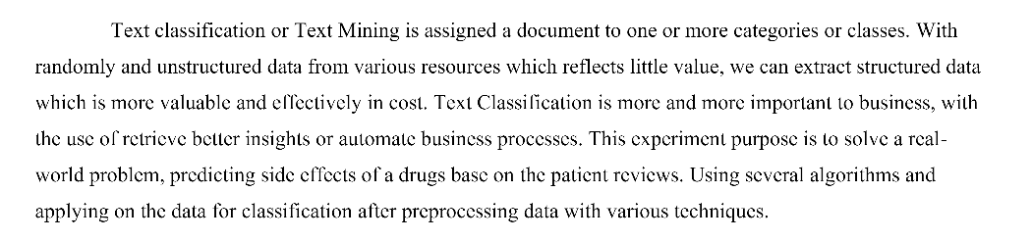

Slide 4
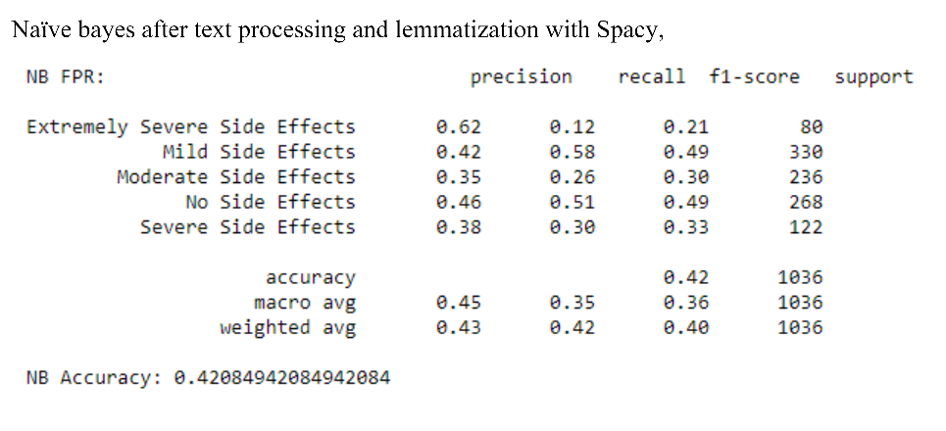
Results
Need to discuss the results obtained. Compare, contrast, trends, etc
Not only screen dumps.

Slide 5
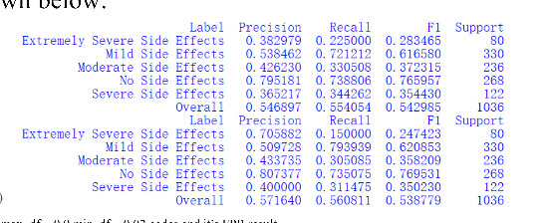
Analysis
Examples
Why a particular category has very high or low rate.
Category by category comparison
Algorithm comparison on overall results
Extreme variations
Results after feature manipulations

Slide 6
Results
Need to answer the task question.
Accuracies of two MLA’s on side effect prediction with and without pre-processing.

Slide 7
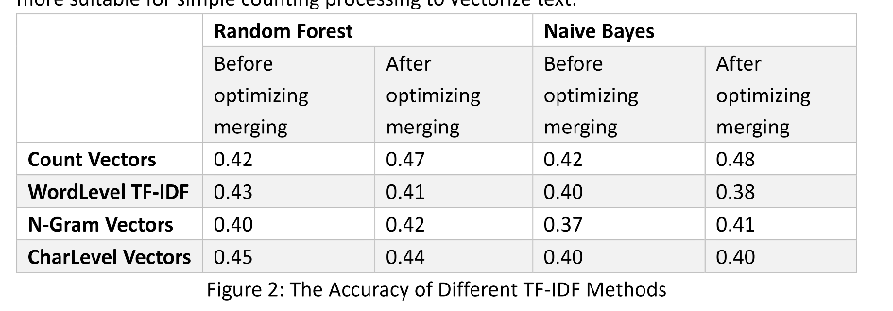
Result presentation

Slide 8
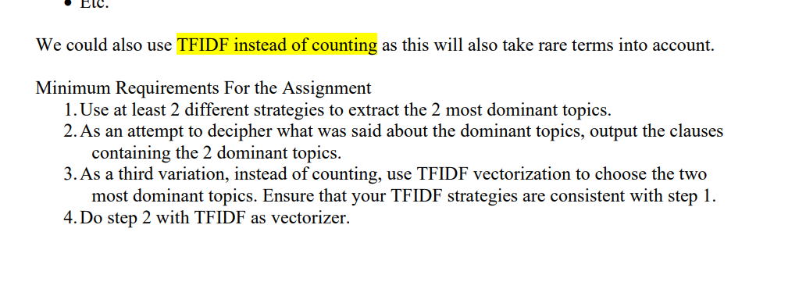
Methodology
Should reflect as closely as possible the tasks

